Slide 1

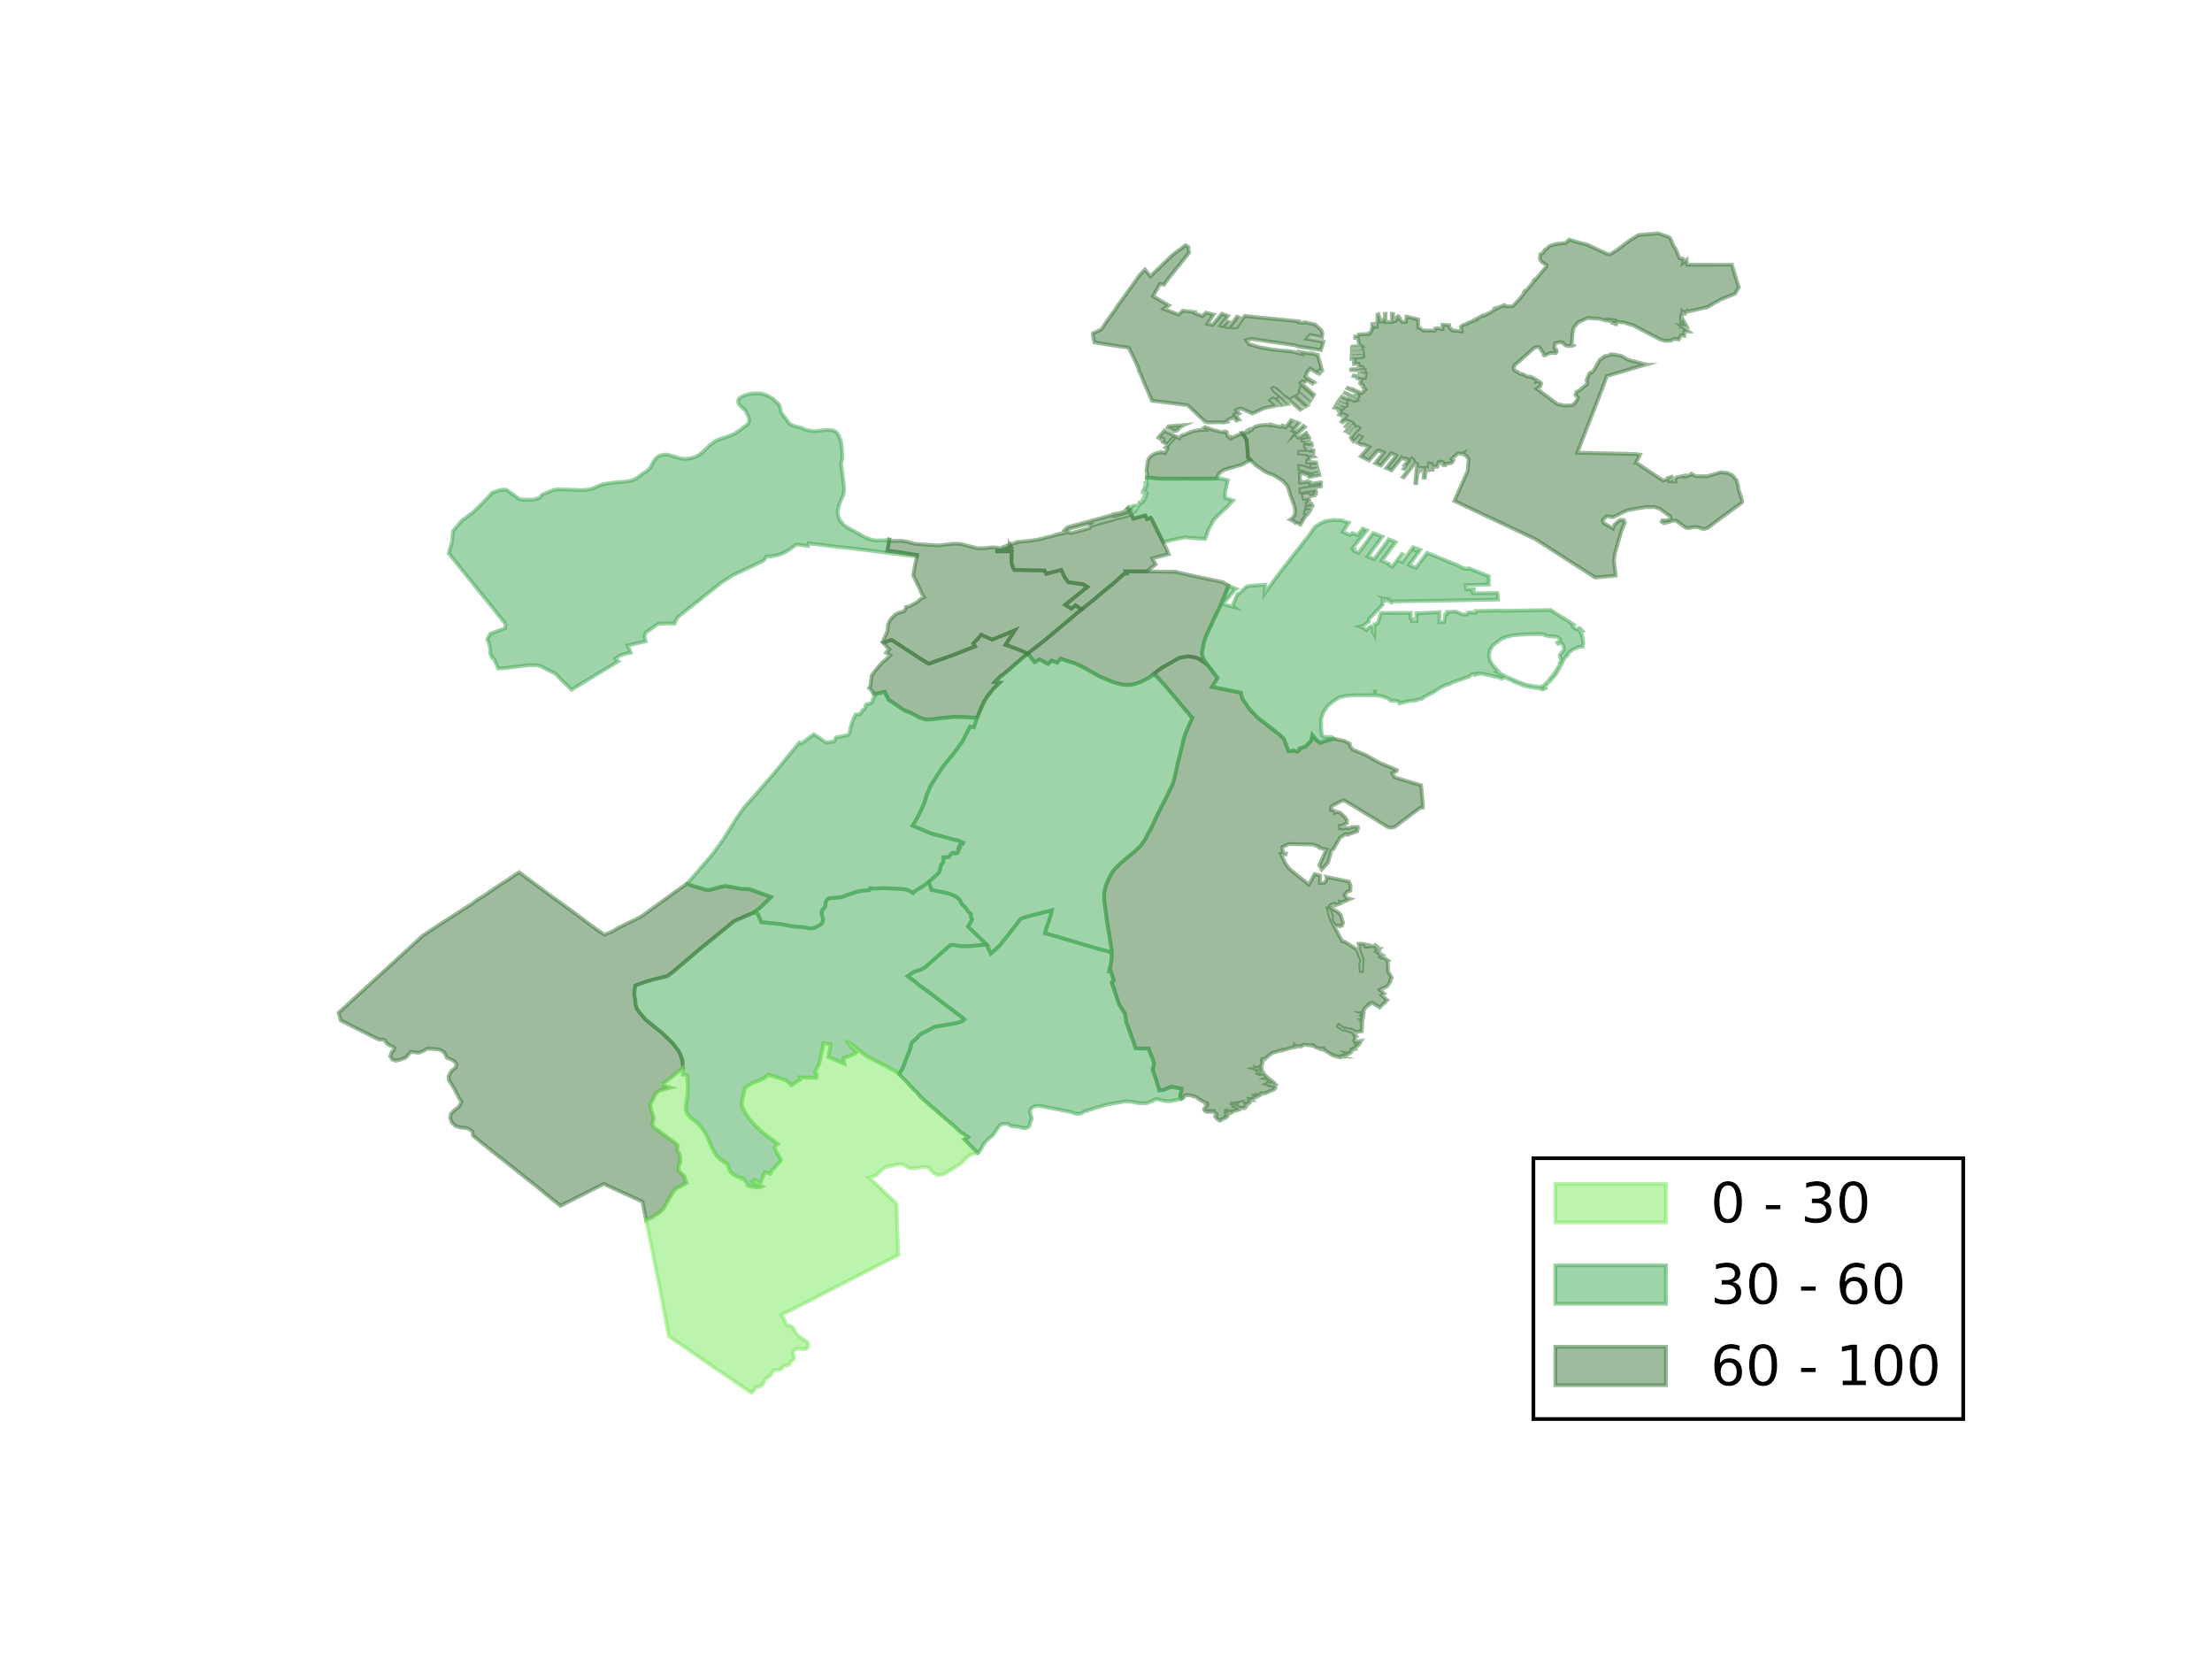
Relationship between food accessibility, income,
and obesity per neighborhood in Boston
Melissa Garcia, Jeraldin Guerrero
CS 591: Data Mechanics
Introduction
With the known health benefits, many cities, restaurants and families are embracing natural and fresh foods. Boston in particular is adopting and diving into the farm-to-table culture. Boston is comprised of multiple neighborhoods. Some neighborhoods being more underdeveloped than others, have less access to food sources that offer unprocessed and non-GMO options. Even if these options are made available, families may not have the income to maintain a healthy lifestyle. Thus, making it much easier to purchase certain groceries out of convenience vs. nutrition facts.
Project Goals
Our project seeks to explore the relationship between food accessibility, obesity, and income in Boston neighborhoods. We believe that we will find that a smaller income and a lack of nearby food sources in a neighborhood will correlate to a higher obesity percentage. In order to do this, we created a method to score each neighborhood based on how accessible their food sources are, and then we used this information to attempt to determine a correlation.
Data
Food Datasets:: We created one combined dataset of all the food sources available in Boston from three datasets: Farmers Markets in Boston and Cornerstores in Boston (Source: data.cityofboston.gov) and Supermarkets in Boston (Source: Boston Redevelopment Authority Research Division). Obesity in Massachusetts Dataset: Dataset that includes the population with a BMI of 30 or higher over the age of 20. (Source: synthpopviewer) Income Information per Neighborhood Dataset: Dataset that contains the median household income per neighborhood. (Source: city-data.com) Master Address Dataset: This dataset contains all of the addresses in the neighborhoods. We extracted the residential addresses and their geographic coordinates from the source to create this dataset. (Source: data.cityofboston.gov)
Food Accessibility Score Per Neighborhood
Statistical Analysis
Method 1: Objective Function
In order to calculate a food accessibility score for each neighborhood we looked at three
important factors to compute scaled z-scores:
The average number of food sources in the neighborhood within walking distance (< 1.0 km) of a residence.
The average distance to the closest food source per residence calculated from all the food sources available
The average quality of the food source within walking distance
We calculated the correlation coefficients between the food
accessibility score, the income, and % obesity per
neighborhood. These values can be seen in the table below.
There is a relatively strong negative correlation between
obesity and income, as well as between the food accessibility
score and obesity. This suggests that a lower income and low
food accessibility score correlate with a high obesity
percentage. However, there doesn't seem to be any correlation
between the food accessibility score and the income.
Neighborhood | Average # of Food Sources | Average Distance to Closest Food Source | Quality of Food Sources | Score
Roslindale | 2.84 | 0.48 | 0.24 | 43.50
West End | 4.00 | 0.29 | 0.42 | 74.65
East Boston | 6.83 | 0.23 | 0.19 | 76.14
Roxbury | 4.26 | 0.38 | 0.13 | 48.52
North End | 4.86 | 0.15 | 0.46 | 90.73
Dorchester | 7.14 | 0.37 | 0.10 | 61.93
Allston/Brighton | 4.26 | 0.38 | 0.11 | 46.78
Hyde Park | 2.82 | 0.57 | 0.12 | 28.20
South Boston | 4.55 | 0.36 | 0.20 | 56.93
Mission Hill | 2.86 | 0.23 | 0.62 | 87.91
Charlestown | 5.70 | 0.28 | 0.40 | 83.44
Mattapan | 4.16 | 0.42 | 0.19 | 49.59
Back Bay | 4.12 | 0.30 | 0.62 | 90.34
Fenway/Kenmore | 7.76 | 0.20 | 0.36 | 95.94
South End | 7.88 | 0.19 | 0.34 | 94.98
Jamaica Plain | 4.70 | 0.45 | 0.29 | 58.97
West Roxbury | 0.95 | 1.05 | 0.26 | 0.00
Financial District/Downtown | 8.50 | 0.23 | 0.39 | 100.00
Beacon Hill | 1.00 | 0.30 | 0.33 | 50.89
Bay Village | 2.00 | 0.19 | 0.33 | 63.05
 | Food Score | Income | Obesity
Food Score | 1.0 | 0.034 | -0.466
Income | 0.034 | 1.0 | -0.543
Obesity | -0.466 | -0.543 | 1.0
Score Visualization of Boston
Conclusion/Future Work
Based on data characterizing Boston’s neighborhoods, we can conclude that there is a
slight relationship between income and food accessibility on incidence of obesity. This
resonates with research being done that frame obesity as a social problem, and one that
can thus be fixed by improving the overall economic outlook of a neighborhood, as well as
increasing food accessibility to better quality food source. However, though the results
looks promising, our sample size of 20 neighborhoods is too small to really allow us to
make any meaningful conclusions about the relationship between food accessibility,
income, and obesity. In the future, we would look to extend this method of analysis to more
cities and their neighborhoods.

